Slide 1
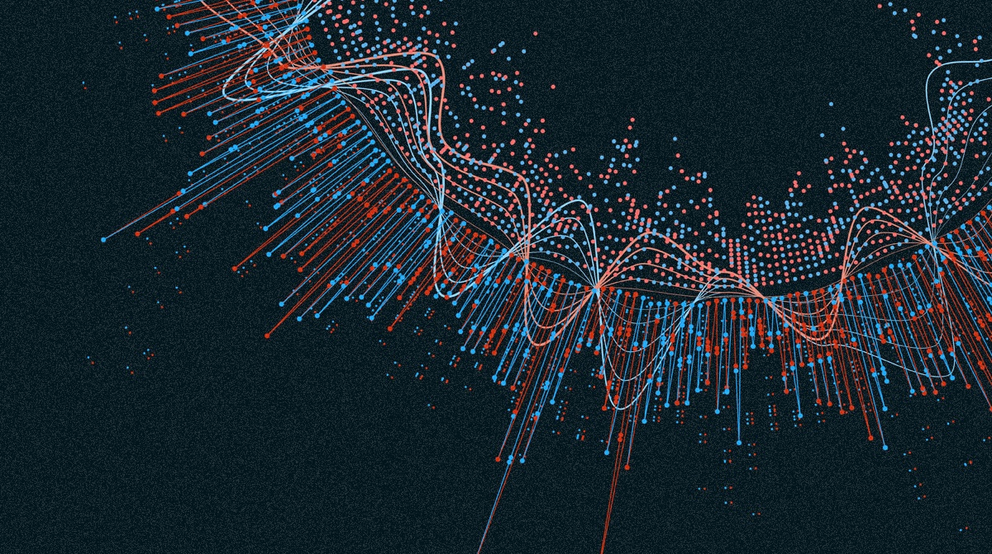
JUNIPER:
ATree+Table Approach to Multivariate Graph Visualization
Written By: CarolinaNobre, MarcStreit, and AlexanderLex
Presented By: Shilpi

Slide 2
INTRODUCTION
IMPORTANT TERMS
Multivariate Graphs
Graphs which contains lots of nodes and attributes. These graphs usually contains hundreds of nodes. Common in fields like biology, social science
Focus Tasks
Refer to tasks where the details of individual nodes, edges, and their neighborhood matter, as opposed to the global structure of the network. Focus tasks commonly require readable labels and a detailed understanding of a node’s attributes.
DOI
Degree of Interest(DOI) refers to the nodes which are most relevant to the user.

Slide 3
About Juniper
Graph Visualization
Juniper is a technique for a Tree + Table approach to multivariate Graph visualization.
Provides Interactive Technique that is tailored to address focus tasks when visualizing large, multivariate networks.
Shortest Path between nodes
Explore Interdependent attributes along paths in the network
Aggregating nodes to save space

Slide 4
About Juniper
Expand the network on Demand
Filter nodes by type
Sorting nodes based on attributes

Slide 5
JUNIPER How it works!!
1
2
3
4
5
Extract the subgraph from a larger, underlying graph
Calculate the spanning tree from the subgraph
Linearize the tree
Juxtapose the tree and the table
Tree+Table Graph is Ready

Slide 6
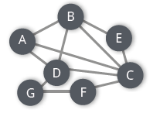
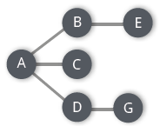
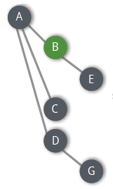
JUNIPER How it works!!
Subtree
Spanning tree
Linearized tree
Tree with Tables
6

Slide 7
CO-AUTHOR
NETWORK
(a) Distribution of papers by authors of TreePlus.

Slide 8
CO-AUTHOR
NETWORK
(b) Individual paper distributions.

Slide 9
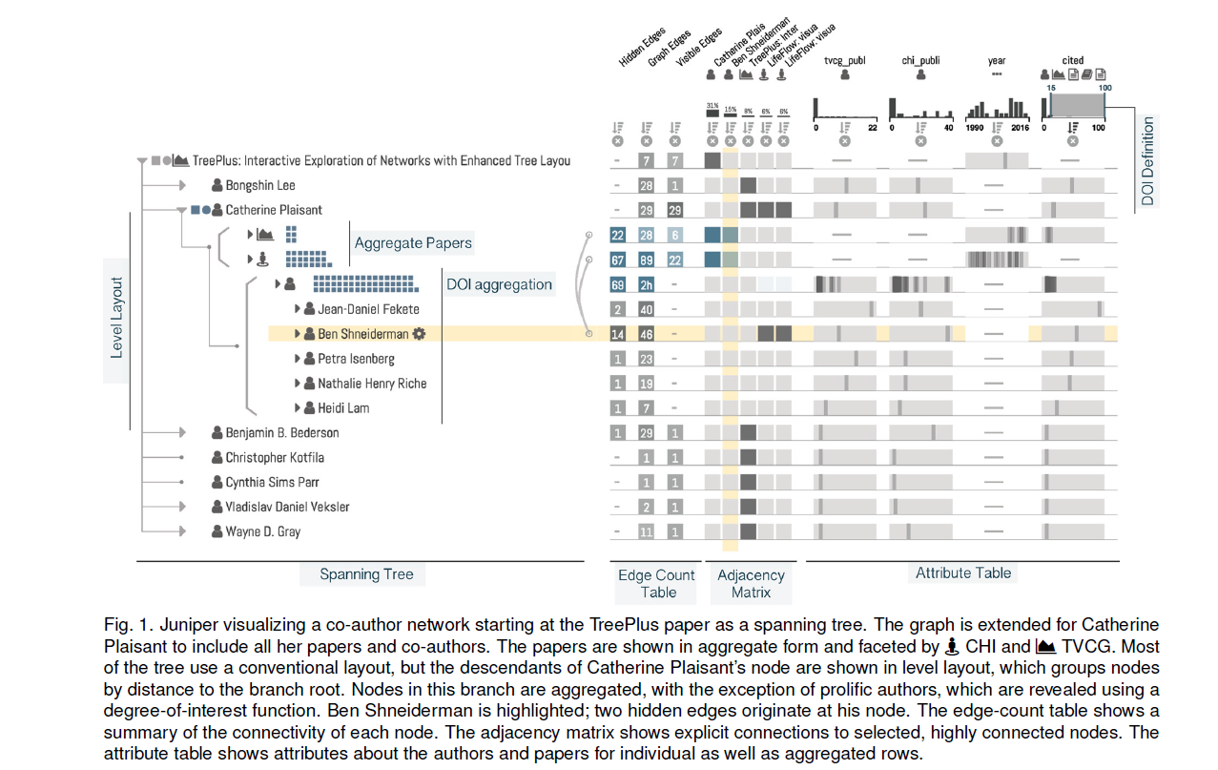
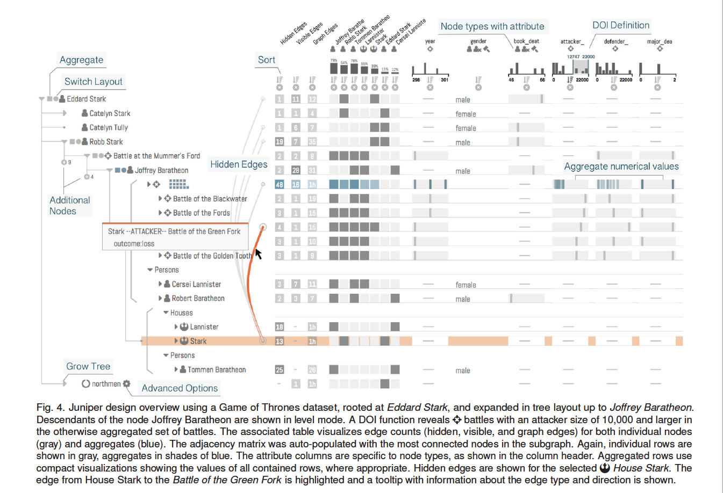
(c) Frequent co-authors of Catherine Plaisant.
CO-AUTHOR NETWORK

Slide 10
Game Of Thrones

Slide 11
DEMO
URL: http://juniper.sci.utah.edu/

Slide 12
Question?
THANK YOU

